Slide 1

Automated Elicitation and Discovery of Human Health and Ecological Indicators for Monitoring of Urban Freshwater Environments
Helit Bauberg
Final Project – MSc Data Science
Supervisor: Prof. Arriel Benis
Holon Institute of Technology (HIT)
September 2024

Slide 2

Introduction One Aqua Health (OAH)
EU funded project
Involves 13 institutions from 9 countries
Links between HEALTH OF NATURE and AQUATIC ECOSYSTEMS and HUMAN HEALTH.
Aim: identify early warning indicators and enhance environmental monitoring by investigating the interconnection of ecosystem health and human wellbeing
Aim: improve the sustainability of freshwater ecosystems in urban environments
OAH project is a part of the One Digital Health (ODH) initiative.
Notes:
OneAquaHealth is a reasearch project that aims to improve the sustainability and integrity of freshwater ecosystems in urban environments.
The project will identify early warning indicators and enhance environmental monitoring by investigating the interconnection of ecosystem health and human wellbeing.
Work Packages (WP2 & WP3):
WP2: Curates ecological and biological indicators.
WP3: Focuses on human health indicators and behaviors.

Slide 3
Introduction One Digital Health (ODH) A Unified Framework for Health Ecosystems
Definition: ODH framework combines One Health and Digital Health to create a holistic approach to health ecosystems.
Scope:
Addresses human health, animal health, and environmental health.
Integrates healthcare, technology, and data using digital tools like AI, machine learning, and data analytics.
FAIR Principles: Ensures data is Findable, Accessible, Interoperable, and Reusable (FAIR) to support research and understanding of complex ecosystems.
Benis A, Tamburis O, Chronaki C, Moen A. One Digital Health: A Unified Framework for Future Health Ecosystems. J Med Internet Res. 2021 Feb 5;23(2):e22189. doi: 10.2196/22189. PMID: 33492240; PMCID: PMC7886486.
Wilkinson MD, Dumontier M, Aalbersberg IJ,…, Zhao J, Mons B. The FAIR Guiding Principles for scientific data management and stewardship. Sci Data. 2016 Mar 15;3:160018. doi: 10.1038/sdata.2016.18. Erratum in: Sci Data. 2019 Mar 19;6(1):6. doi: 10.1038/s41597-019-0009-6. PMID: 26978244; PMCID: PMC4792175.
Tamburis O, Benis A. One Digital Health for more FAIRness. Methods Inf Med. 2022 Dec;61(S 02):e116-e124. doi: 10.1055/a-1938-0533. Epub 2022 Sep 7. PMID: 36070786; PMCID: PMC9788917.
Notes:
ODH creates a unified approach, acknowledging that human, animal, and environmental health are interconnected. It provides a roadmap for integrating digital technologies into health ecosystems, leveraging tools like AI and data science.
FAIR data principles help ensure that valuable resources are accessible to the scientific community, aiding in early detection of trends and changes within ecosystems.

Slide 4
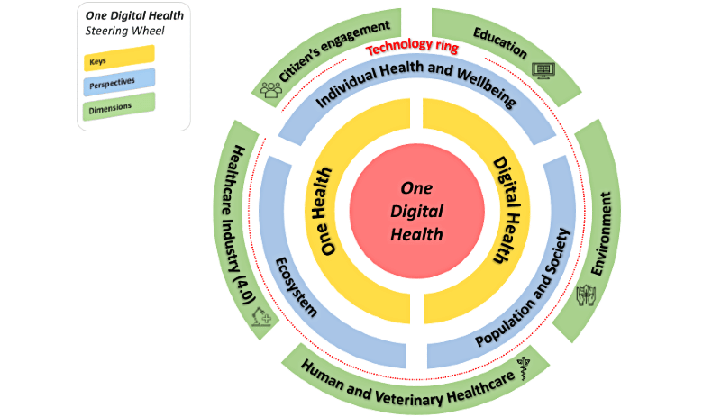
Introduction ODH Steering Wheel
Importance of integrating human, animal, and environmental health through AI and data analytics.
Emphasis on technology
Benis A, Tamburis O, Chronaki C, Moen A. One Digital Health: A Unified Framework for Future Health Ecosystems. J Med Internet Res. 2021 Feb 5;23(2):e22189. doi: 10.2196/22189. PMID: 33492240; PMCID: PMC7886486.
Notes:
The conceptual framework of the One Digital Health Steering Wheel is built around two keys (ie, One Health and digital health), three perspectives (ie, individual health and well-being, population and society, and ecosystem), and five dimensions (ie, citizens' engagement, education, environment, human and veterinary health care, and Healthcare Industry 4.0).
One Digital Health aims to digitally transform future health ecosystems, by implementing a systemic health and life sciences approach that takes into account broad digital technology perspectives on human health, animal health, and the management of the surrounding environment.

Slide 5
AI, Data Science and ODH: Key Applications
ML/AI Overview:
ML/AI tools imitate or surpass human cognitive abilities.
Used for domain-specific tasks like decision-making, health monitoring, and data analyses.
Core ML/AI Tasks in DS Applications:
Data Curation & Classification: Efficient sorting and analysis of large datasets from sources like PubMed.
Pattern Recognition & Analytics: Identifying trends in genome data, disease transmission, and climate impacts.
Predictive Modeling & Simulation: Forecasts in healthcare (e.g., drug efficacy) and environmental studies (e.g., climate change effects).
Russell SJ, Norvig, P (2020). Artificial Intelligence: A Modern Approach (4 ed.). Prentice Hall. p. 1136.
ISBN 978-0-13-461099-3. OCLC 359890490.
Notes:
AI plays a pivotal role in ODH by enabling researchers to handle vast datasets, offering faster insights and decision-making support.
Through tasks like predictive modeling, AI helps simulate real-world scenarios in healthcare and environmental management, proving its critical utility in interdisciplinary research.

Slide 6
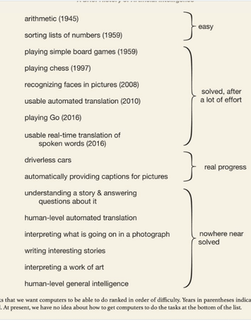
Conversational AI and Generative AI in the ODH Framework
Conversational AI (LLMs):
Advanced models (e.g., ChatGPT, Gemini, Llama) trained on vast text data.
Capable of natural language understanding and generation, used for chatbots and virtual assistants.
Generative AI (GenAI):
Creates novel content (text, images, music) from learned data patterns.
Solves complex interdisciplinary problems (e.g., medicine, coding, and vision).
Challenges: Concerns about bias, ethics, and data integrity need addressing for full adoption in ODH.
Wooldridge, Michael J. A Brief History of Artificial Intelligence: What It Is, Where We Are, and Where We Are Going. Flatiron Books, 2021.
Bubeck, S., Chandrasekaran, V., Eldan, R., Gehrke, J., Horvitz, E., Kamar, E., ... & Zhang, Y. (2023). Sparks of artificial general intelligence: Early experiments with gpt-4. arXiv preprint arXiv:2303.12712.
Notes:
LLMs, such as ChatGPT (nov 22) and Gemini, have revolutionized conversational AI, offering more dynamic and context-aware dialogues.Generative AI adds another layer by creating entirely new content, making it invaluable for interdisciplinary fields within ODH. However, AI limitations in bias and ethical considerations remain critical areas for improvement.
Image from ‘A brief history of AI’, published Jan 21.

Slide 7
Research Aims and Objectives
Aim
Contribute to the understading and to the sustainable management of urban freshwater ecosystems through advancing AI and NLP integration in the OAH project
Objectives
Develop an AI-powered platform for indicator identification.
Automate systematic literature review using LLMs and NLP.
Validate platform effectiveness in supporting OAH objectives.
Notes:
(aim) the research aims to demonstrate how AI, and more precisely, NLP driven models, can support the identification and monitoring of ecological and health indicators that connect human, animal, and environmental health
(objective) This will involve generating reports that support the detection of disease vectors, environmental health proxies, and early warning indicators for ecosystem degradation, report repeating themes and suggest hypothesis

Slide 8
Research Goals
A functional AI, NLP-powered platform to support OAH objectives by processing, analyzing, and generating insights from diverse data sources.
Improved understanding of the links between human health, animal health, and environmental health within OAH domains
Practical recommendations for the broader application of AI and NLP tools in other ODH-related projects, focusing on scalability and adaptability
Notes:
Apecifically, …

Slide 9
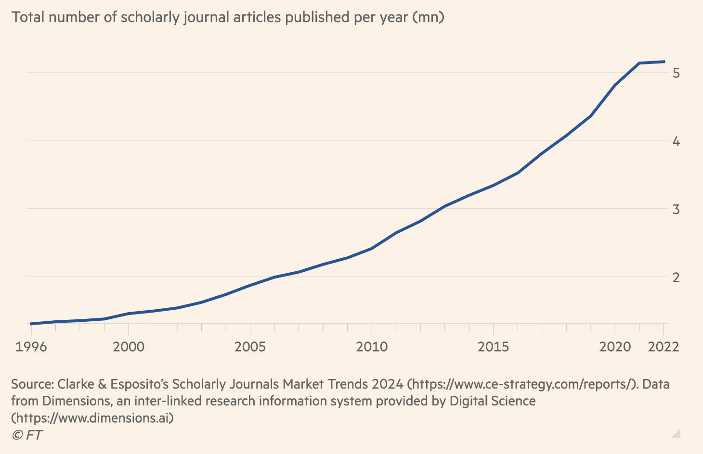
Challenges of Manual Literature Review
Exponential growth in scientific publications
Manual review is resource-intensive, time-consuming, prone to human biases
LLMs provide an alternative with faster processing, scalable to larger data sets.
Notes:
Illustrate the limitations of manual reviews: labor, time, and comprehensiveness.
Highlight how LLMs automate and enhance the review process with instruction-following capabilities in natural language.

Slide 10
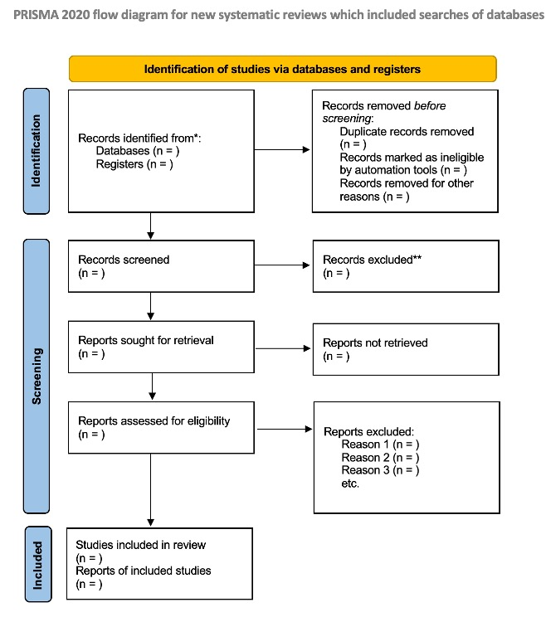
PRISMA: Preferred Reporting Items for Systematic reviews and Meta-Analyses Flow Diagram
Liberati A, Altman DG, Tetzlaff J, Mulrow C, Gøtzsche PC, Ioannidis JP, Clarke M, Devereaux PJ, Kleijnen J, Moher D. The PRISMA statement for reporting systematic reviews and meta-analyses of studies that evaluate healthcare interventions: explanation and elaboration. BMJ. 2009 Jul 21;339:b2700. doi: 10.1136/bmj.b2700. PMID: 19622552; PMCID: PMC2714672.

Slide 11
OAH-AI Framework System Architecture
OAH-AI adopts the PRISMA protocol for systematic literature reviews.
Python framework, NLP driven via API calls to OpenAI and Google LLMs
Part I: OAH-AI PRISMA Systematic Review Process
LLMs are reasoning and inference engines
Part II: OAH-GenAI Creative Review Process
LLMs are inference and generative engines
Liberati A, Altman DG, Tetzlaff J, Mulrow C, Gøtzsche PC, Ioannidis JP, Clarke M, Devereaux PJ, Kleijnen J, Moher D. The PRISMA statement for reporting systematic reviews and meta-analyses of studies that evaluate healthcare interventions: explanation and elaboration. BMJ. 2009 Jul 21;339:b2700. doi: 10.1136/bmj.b2700. PMID: 19622552; PMCID: PMC2714672.
Notes:
Explain the purpose of the OAH-AI framework: to automate labor-intensive systematic reviews and leverage AI for insights.
Emphasize the dual goals: (1) systematic review (PRISMA flow) and (2) Generative AI-driven discovery.

Slide 12
OAH-AI PRISMA Part I: Systematic Review with LLMs
OAH-AI Part I focuses on literature review using LLMs
Four Step Pipeline:
Identification
Screening
Eligibility
Full Text Assessment
LLMs provide reasoning and natural language processing at each step, with outputs categorized and structured.
Papers move through PRISMA’s pipeline - only valid papers forwarded downstream.
Outputs are human-readable for further analysis.
Notes:
Each step produces outputs in formats (txt, csv, json) that allow human review before proceeding to the next step.
Stress the importance of human validation in ensuring AI outputs are relevant and accurate, this also ensures transparency and the option to revise results.

Slide 13
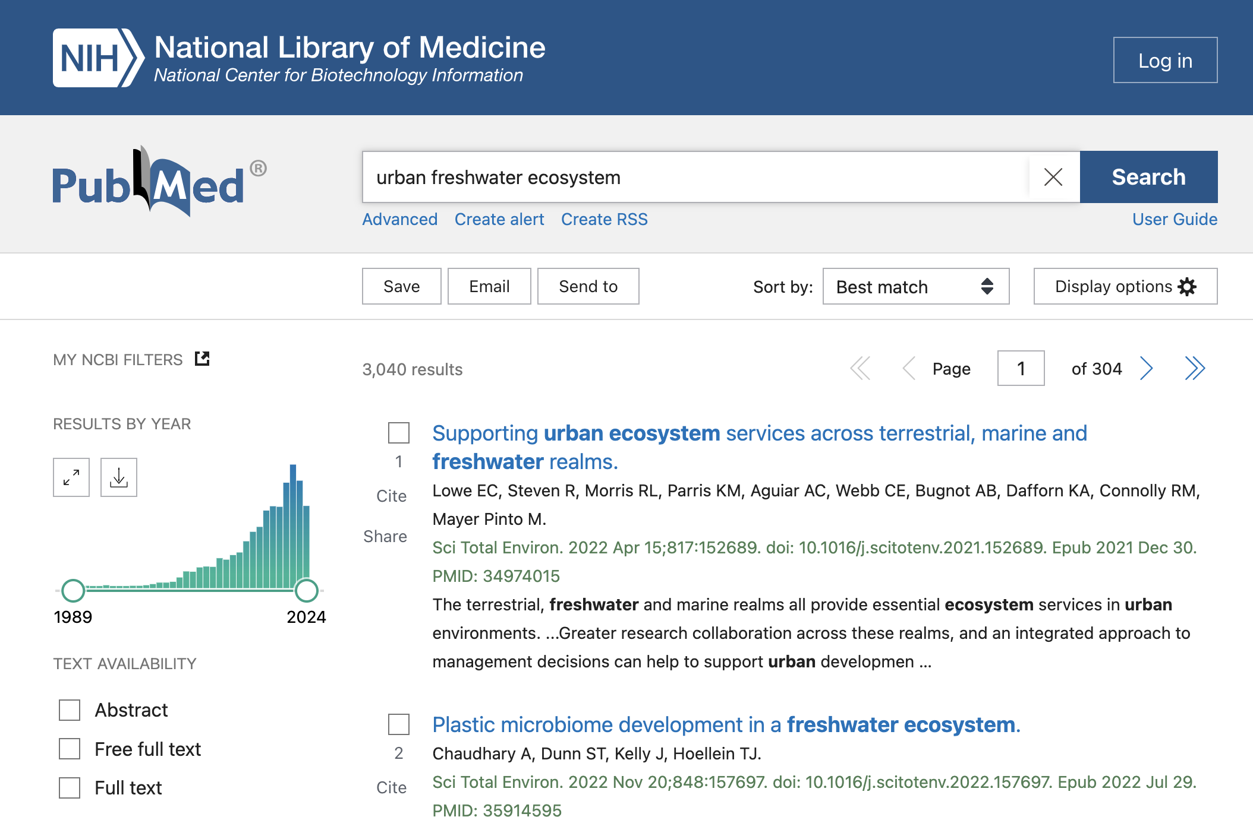
OAH-AI PRISMA Part I: Step 1: Identification
Not LLM-driven
All scientific papers matching <OAH Search Queries> retrieved from PubMed and loaded into the framework’s data structures.
Per paper, metadata and abstract are extracted
All results saved to text file in Medline format

Slide 14
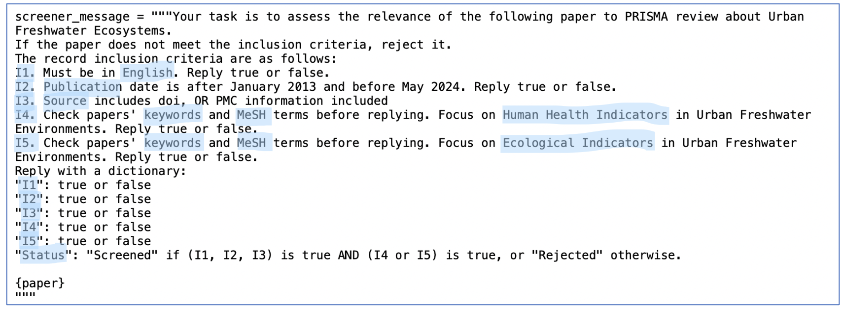
OAH-AI PRISMA Part I: Step 2: Screening
Input: Identified papers abstract and metadata
LLM functionality: LLM is prompted to evaluate input text
Output: Text and csv files containing decision for all identified papers

Slide 15
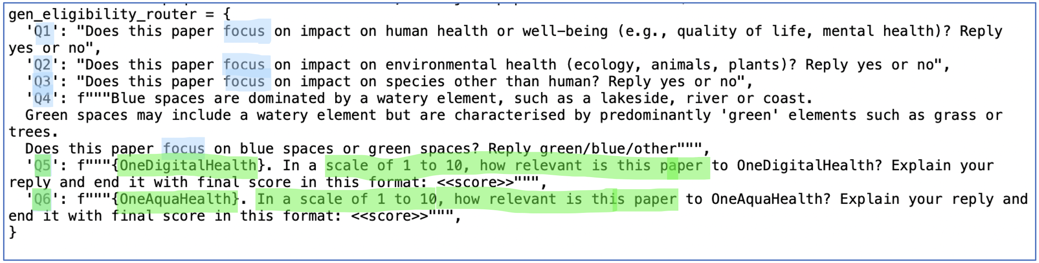
OAH-AI PRISMA Part I: Step 3: Eligibility
Input: Screened papers full text pdf files
LLM functionality: Inference and reasoning: prompted to assess paper relevance to ODH, OAH through a list of questions
Output: CSV file containing ODH, OAH relevance scores; json file containing all extracted information per paper
Notes:
PRISMA eligibility step determines which Screened papers should be included or excluded from the systematic review, based on a set of criteria. These criteria are determined by factors such as relevance to the research question, study design, population, interventions and outcomes. Papers that fail to meet these criteria will not be analyzed in the final review process.
In the previous steps, OAH-AI framework relied on papers’ metadata analyses to determine its inclusion status – the data was enough. But a reliable eligibility assessment of the Screened papers, must include full text assessment

Slide 16
OAH-AI PRISMA Part I: Step 3: Eligibility Output Examples LLM: Gemini
PMID: 38181685
Title: Protecting and restoring freshwater biodiversity across urban areas in Aotearoa New Zealand: Citizens' reporting of pollution in stormwater drains and waterways.
LLM Reply - ODH Score:
The paper focuses on freshwater biodiversity and how human behavior impacts it. While it mentions the importance of community engagement and environmental stewardship, it doesn't directly address the broader digital health ecosystem or the interconnectedness of human, animal, and environmental health as envisioned by One Digital Health.
<<3>>
LLM Reply - OAH Score:
This paper directly addresses the challenges of urbanisation on freshwater ecosystems and the need for intervention to protect and restore biodiversity. It focuses on citizen reporting of pollution as a key behavior to improve urban freshwater health. This aligns with OneAquaHealth's goal of improving the sustainability and integrity of freshwater ecosystems in urban environments by identifying early warning indicators and enhancing environmental monitoring.
The paper's focus on citizen engagement and behavior change strategies is particularly relevant to OneAquaHealth's aim of investigating the interconnection of ecosystem health and human wellbeing.
<<9>>
Notes:
PRISMA eligibility step determines which Screened papers should be included or excluded from the systematic review, based on a set of criteria. These criteria are determined by factors such as relevance to the research question, study design, population, interventions and outcomes. Papers that fail to meet these criteria will not be analyzed in the final review process.
In the previous steps, OAH-AI framework relied on papers’ metadata analyses to determine its inclusion status – the data was enough. But a reliable eligibility assessment of the Screened papers, must include full text assessment

Slide 17
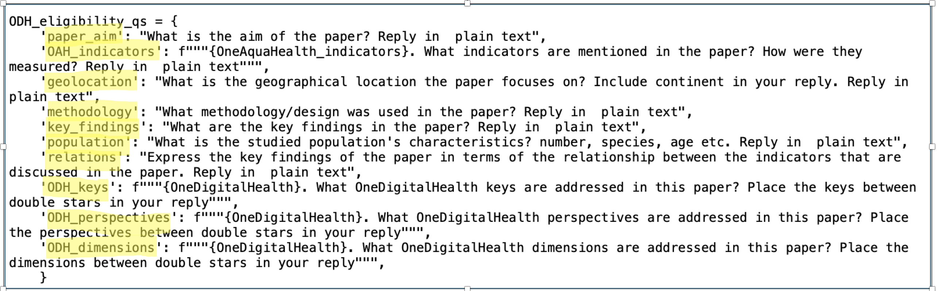
OAH-AI PRISMA Part I: Step 4: Full Text Assessment
Input: Eligible papers full text pdf files
LLM functionality: Reasoning (LLM selector) and Inference (prompted to extract scientific findings from paper)
Output: CSV file containing ODH, OAH relevance scores; json file containing all extracted information per paper

Slide 18
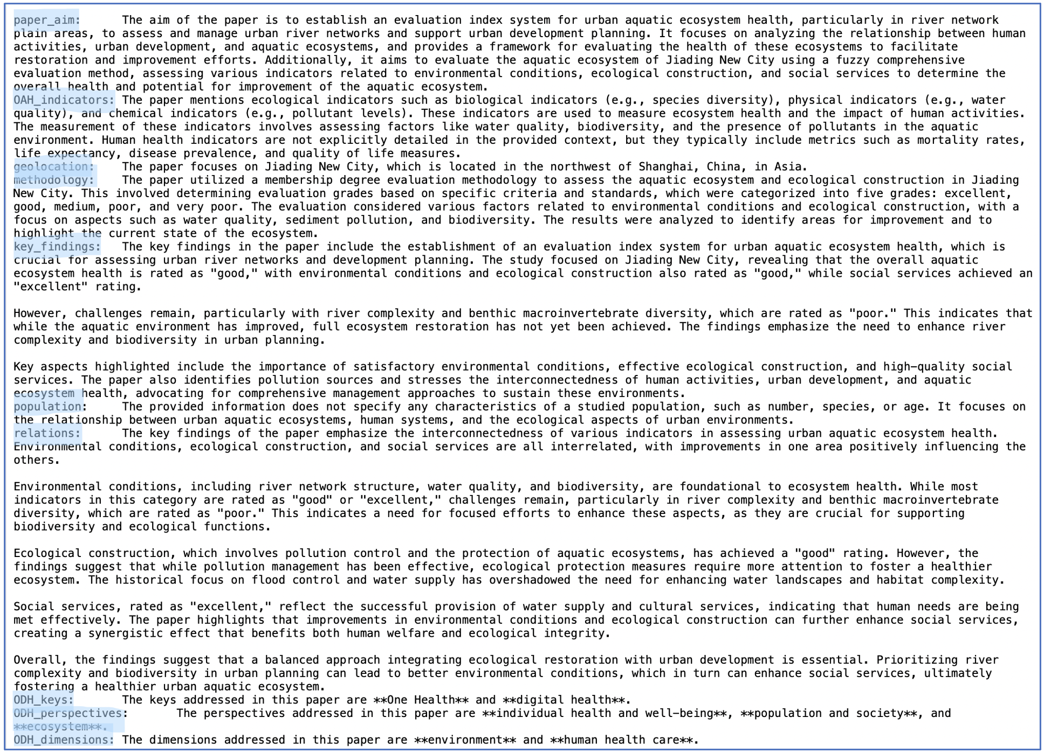
OAH-AI PRISMA Part 1: Step 4: Full Text Assessment Output Examples LLM: OpenAI Output token count: 1159 LLM processing time: 61.8 sec

Slide 19
OAH-AI PRISMA Part 1: Step 4: Full Text Assessment
.
.
.
Output Examples LLM: OpenAI Output token count: 1159 LLM processing time: 61.8 sec

Slide 20
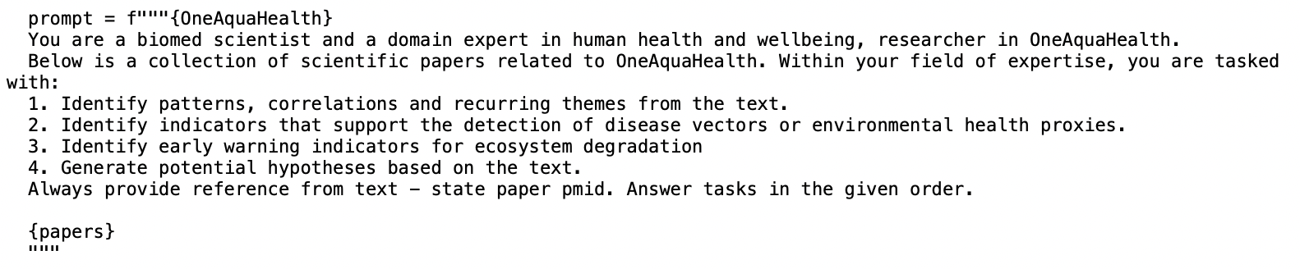
OAH-AI GenAI Part II: Generate Insights from Corpus
Preprocessed, digested corpus of Fully Eligible papers now treated as one dataset
Two steps pipeline:
Generate Ideas on partial random subset of papers.
Consolidate all ideas into one concise report
Creativity via temperature, batch randomness

Slide 21
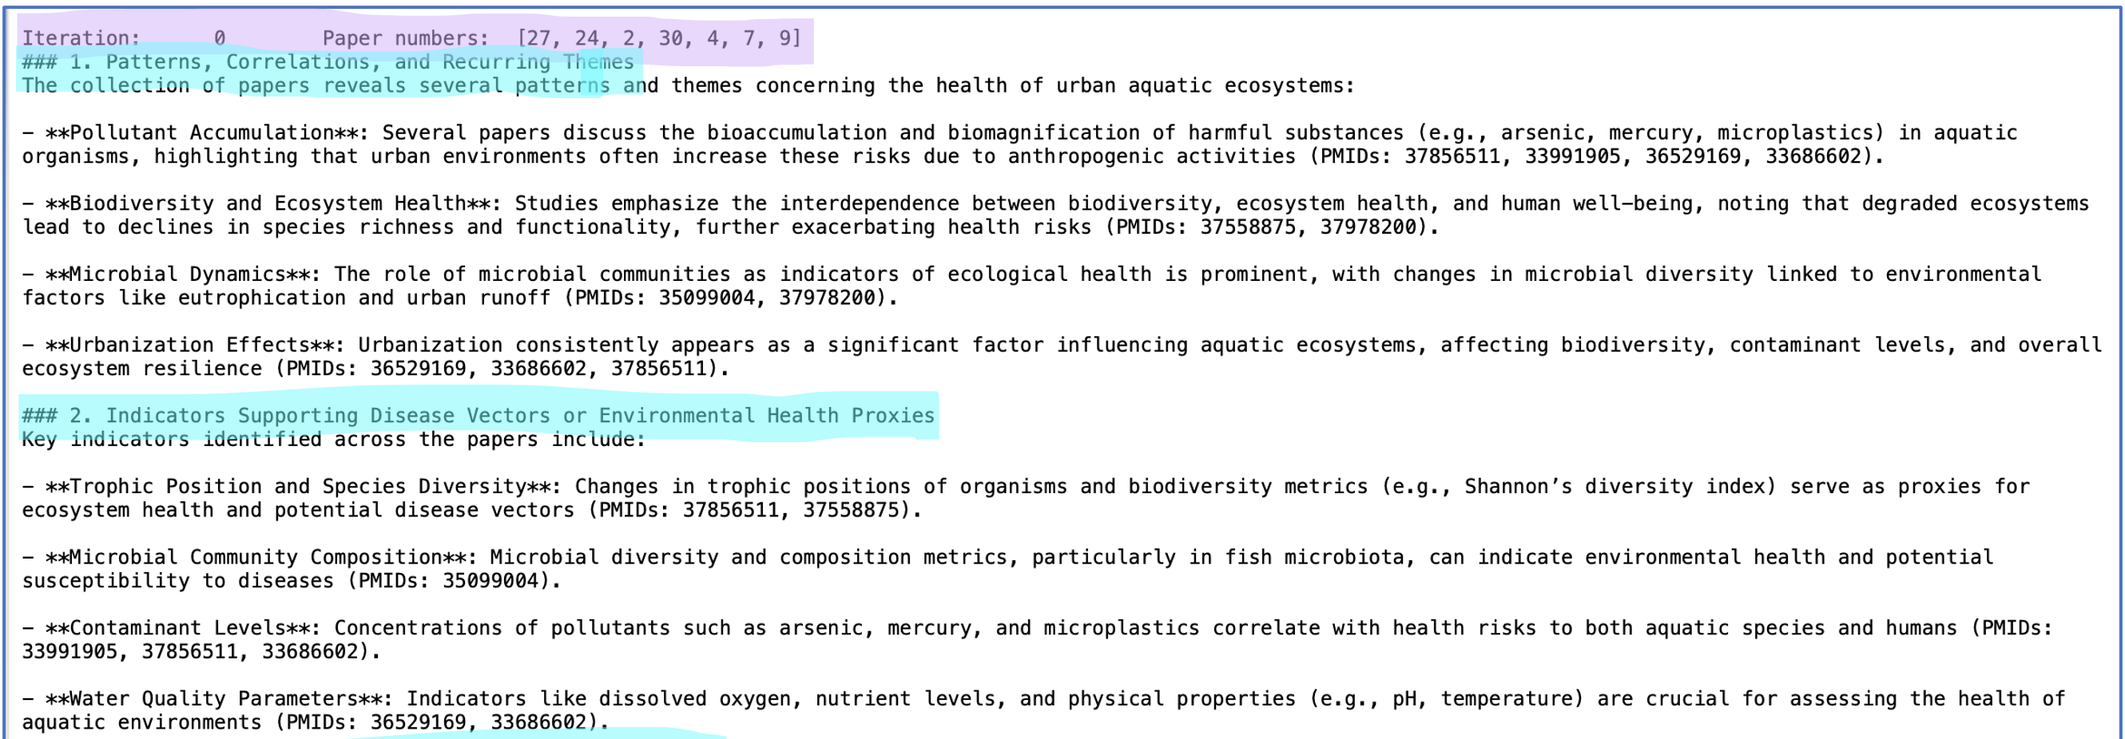
OAH-AI GenAI Part II: Generate Insights from Corpus
.
.
.
Output Examples - Ideas LLM: OpenAI

Slide 22
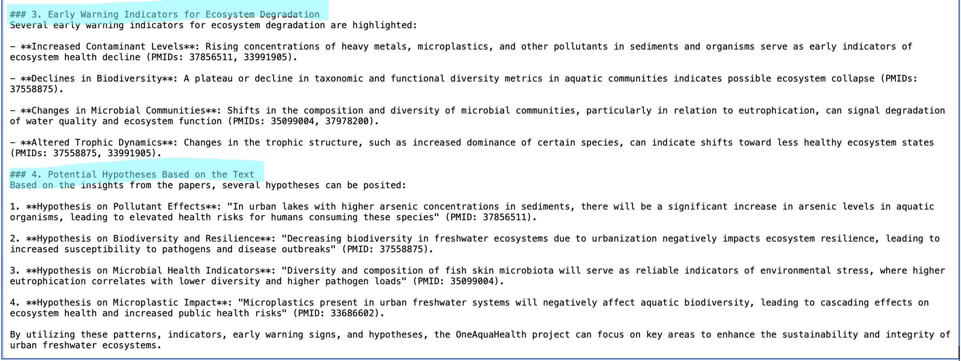
OAH-AI GenAI Part II: Generate Insights from Corpus
.
.
.
.
.
.
Output Examples - Ideas LLM: OpenAI

Slide 23
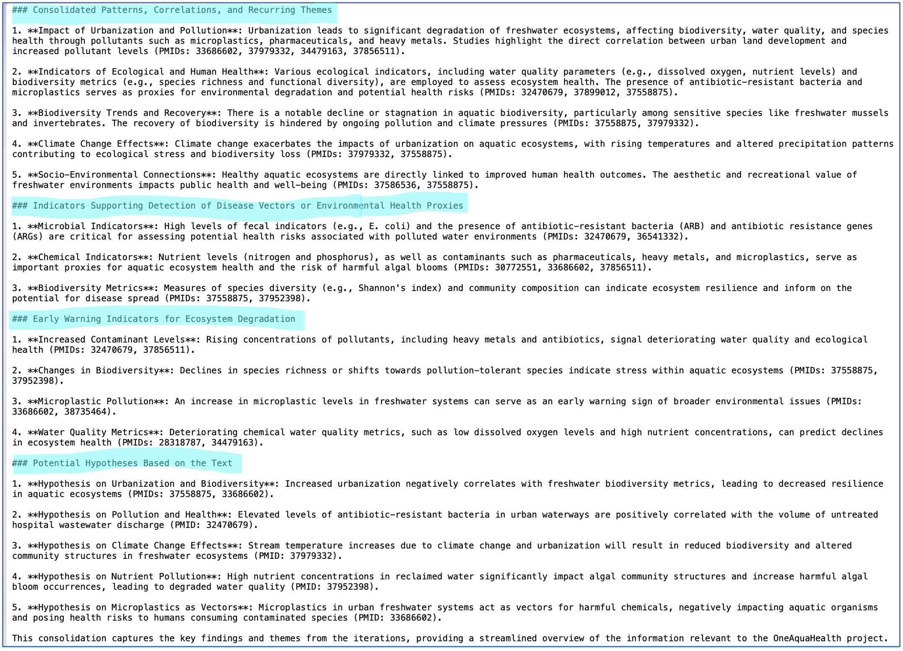
OAH-AI GenAI Part II: Generate Insights from Corpus Output Examples - Final Report LLM: OpenAI

Slide 24
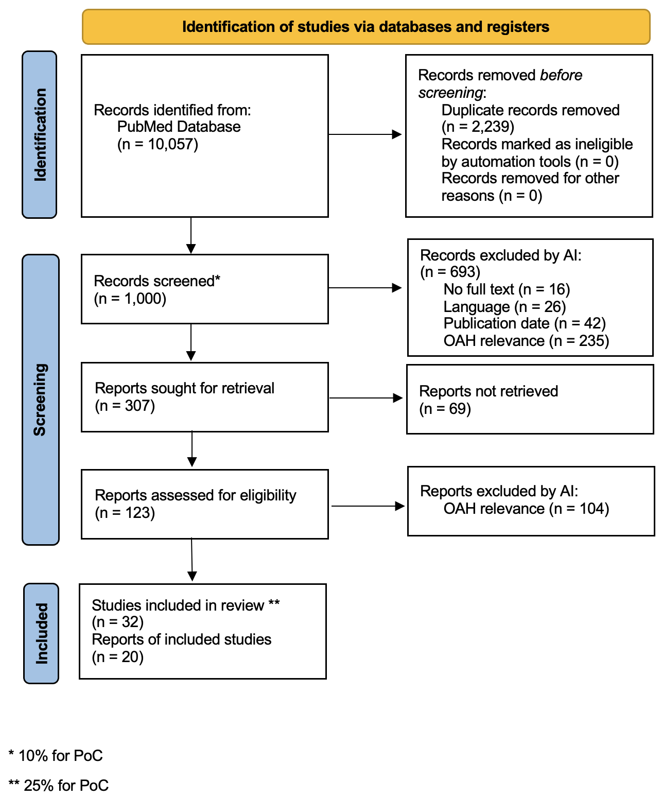
OAH-AI Framework PoC Results PRISMA Flow Diagram
Notes:
* 10% for PoC
** 25% for PoC
We began the process with 1,000 papers and first performed an initial screening based on metadata, which narrowed it down to 307 papers.
Of these, 238 were assessed for eligibility, and 123 papers were selected for full-text review. 30% (32 papers) of those were sent to Part2 for GenAI insights

Slide 25


OAH-AI Methods LLM Selection
OpenAI LLM: Google LLM:
GPT-4o-mini Gemini-1.5-flash
Following experiments, different LLMs applied at each step:
Screening: Both LLMs
Eligibility: Gemini
Full Text: OpenAI’s GPT
Notes:
Throughout this process, we used both OpenAI's and Google's language models. For the Screening phase, we had both LLMs act as screening agents. For the Eligibility step, only Gemini was used, and for the Full Text Assessment, we relied on OpenAI.
This combination of different models allowed us to evaluate their strengths in inference, logical reasoning, and relevance detection.
We began with small-scale experiments to fine-tune how each model would perform, applying them selectively in different stages of the review process.
This adaptive use of LLMs enhanced the efficiency and precision of the overall analysis.

Slide 26
OAH-AI Framework PoC Results Key Points
Entire pipeline completed in under 3 hours:
 | OpenAI | Gemini
Screening - 1,000 papers | 17 min | 11 min
Eligibility - 238 papers | - | 77 min
Full text Assessment - 32 papers | 48 min | -
Total | (17 + 11 + 77 + 48) = 153 min = 2 h 33 min
Notes:
The LLM-driven process drastically accelerates the discovery of health and ecological indicators.
Comparison with manual literature review timelines.
!! ADD processing times for the various step

Slide 27
OAH-AI Framework PoC Results Key Points
Multi-LLM selection strategies improve quality of outputs
LLM-generated outputs: concise, accurate, and well-phrased.
GPT-4o-mini outperforms Gemini-1.5-flash

Slide 28
Discussion GenAI, Heuristic Discovery and OAH
Generative Search Spaces:
Scientific Discovery as a generative process
Search spaces are not predefined but evolve dynamically
Heuristic approach vs. exhaustive research
Role of Generative AI:
To explore new insights from huge data
Not necessarily reproducible by definition
LLMs serve as heuristic tools to propose Hypotheses and support OAH project
Langley, Pat. Scientific Discovery: Computational Explorations of the Creative Processes. The MIT Press, 1987.
Notes:
n scientific discovery, search spaces are inherently generative, meaning they evolve from a starting point rather than from a fixed set of possibilities.
Generative AI models, particularly large language models (LLMs), play a crucial role in exploring these spaces. They can generate hypotheses, patterns, and explanations, making them invaluable in fields like planning, game AI, and now scientific research.
LLMs are heuristic tools that guide researchers by identifying potential relationships that might be challenging to spot manually.
In the OAH-AI study, we embraced a heuristic approach, focusing on exploration rather than exhaustive research. The goal was to explore "what’s out there" by leveraging the generative power of LLMs.
Instead of focusing on strict reproducibility, we allowed LLMs to generate new hypotheses and identify emerging patterns related to urban freshwater environments.
This approach is aligned with exploratory research, where the aim is to open up new areas for investigation, rather than provide final answers.

Slide 29
Discussion LLM Creativity vs. Predictability
Controlling LLM Responses via:
Prompt Engineering:
Structured vs. free-form responses
Example: “Reply yes or no” vs. creative insights
Temperature Setting:
Low temperature for structured reasoning
Precise, logical responses
Screening, Eligibility steps
High temperature for hypothesis generation
Creative, exploratory insights
Full text, corpus assessment steps
Notes:
We used two mechanisms to control the LLMs’ responses: prompt engineering and temperature setting.
For structured, precise tasks, we used prompt engineering to ask for specific, structured responses, such as "yes/no" answers or final scores in a certain format.
The temperature setting controls the randomness of LLM outputs. A low temperature ensured more deterministic, logical reasoning for tasks requiring precision. Meanwhile, a higher temperature facilitated creativity, enabling the models to generate hypotheses and explore correlations.

Slide 30

Discussion Experimenting with LLMs
Initial limitations with API access and free-tier constraints.
Migration to paid subscription for scalability.
Evolution from Llama to GPT-3.5-turbo to GPT-4o and Gemini 1.5.
Continuous updates and improvements in LLM performance.

Slide 31
Discussion Open-Source vs. Closed-Source LLMs
Closed-Source Models:
High performance but costly (e.g., GPT-4, Gemini)
Limited transparency and adaptability
Open-Source Models:
Greater flexibility (e.g., Meta’s Llama, Palmyra-Med)
Challenges: resource constraints, lower performance in free tiers
Notes:
We also considered the debate between closed-source and open-source LLMs. Closed-source models like GPT-4 and Gemini offer cutting-edge performance, but come with high costs and limited transparency.
Open-source models such as Meta’s LLaMA provide more flexibility, but have limitations, especially in free-tier environments where they can struggle with performance. Despite the potential of open-source LLMs, we chose to use the more powerful, commercially available models due to their cost-efficiency and reliability in handling our research tasks.

Slide 32
Discussion Human-in-the-Loop for Domain-Specific Tasks
Need for Human Oversight:
LLMs need guidance in specialized domains like ecology and health
Hybrid Model:
Domain experts validate LLM outputs during eligibility and full-text assessment
Ensures accuracy and context relevance in the OAH-AI framework
Notes:
While LLMs are powerful, they require human oversight in specialized domains like human health and ecology, where understanding and interpreting nuanced data is critical.In our approach, we used a human-in-the-loop method, where domain experts guided and validated the LLMs’ outputs, especially during eligibility and full-text review. This hybrid model ensures that the AI-generated insights are accurate and contextually meaningful.

Slide 33
Discussion RAG and Context Window
Context Window Challenge
Initial challenge: Limited context windows in LLMs
NOW:
GPT-4o-mini: 128,000 tokens
Gemini: 1 million tokens
Retrieval-Augmented Generation (RAG)
Used RAG to query and retrieve relevant text sections
Enables handling large datasets in the OAH-AI framework
Notes:
One key challenge we faced was the context window limitation—how much text an LLM could process in a single prompt. Earlier versions of GPT-4 had limits of 8,000 to 32,000 tokens, but newer models, such as GPT-4o-mini and Gemini-1.5-flash, dramatically extended these limits.
To handle larger datasets initially, we used Retrieval-Augmented Generation (RAG), which queries an external corpus and feeds only the most relevant sections back into the model for analysis. This method was highly effective before the token limits expanded.

Slide 34
Discussion Ethics and Safety
Potential biases and data integrity in LLMs.
The role of human-in-the-loop for oversight.
Green Informatics: reducing the environmental impact of AI systems.

Slide 35
Future Work
Next Steps:
Migration to leading cloud platforms.
Provide user friendly Web GUI
Use of open-source LLMs and stronger database management.
Expansion to other domains and multilingual capabilities.
Building a multidomain knowledge graph

Slide 36
Research Goals Achievements
Successful integration of AI for identifying health and ecological indicators.
Accelerated literature review using LLMs.
Contribution to OAH in understanding the interconnectedness of human, animal, and environmental health.
Notes:
In conclusion, this proof of concept demonstrates the feasibility and potential of integrating LLMs into the OAH-AI framework for large-scale corpus analysis.

Slide 37
Key Takeaways
The OAH-AI framework has demonstrated the power of AI and NLP in accelerating complex research processes.
Future AI research must balance efficiency, ethical considerations, and sustainability.

Slide 38
Q&A
Questions & Discussion

